Slide 1
Reflecting the Unique
Goals of Our Clients
Presented to Pasadena Angels | November 6, 2019
Nick Stonnington
President
Nicholas Stonnington, JR., AIF®, CPFA
Vice President
SEC Registered Investment Advisor | Member FINRA, MSRB, SIPC
1

Slide 2
Client-centric, Whole-team Approach
We know you have unique goals and plans for your future. That’s why we take a personalized, whole-team approach to wealth management and financial planning. Year after year, you can count on us to help you achieve your financial goals.
2

Slide 3
Investment Philosophy
Our investment philosophy carries forward our fiduciary standard, whereby we spend time learning about our clientʼs financial circumstances, goals, and constraints prior to investing their money. We put together a financial plan and review it with our clients and then deploy their capital.
3

Slide 4
“Successful investment is about managing risk, not avoiding it.”
Benjamin Graham
4

Slide 5
Investment
Process
Identify Your
Financial Goals
Proactive Communication to Ensure Your Plan Evolves as Your Needs Change
As circumstances change, we constantly review your investment portfolios and speak to you to ensure that your investment allocation continues to make sense, and if not, we adjust your investments.
Identify Your Risk Preferences and Liquidity Needs
Continuously Monitor and Adjust Your Portfolio
Develop Investment Strategies Based on Your Needs and Goals
Execute the Strategies, Adhering to Our Investment Philosophy
5

Slide 6
At Your Service
We offer a wide range of customizable services, and our experienced, results-oriented team knows how to connect the dots between tax strategies, estate planning, and investing to grow your wealth and preserve your legacy.
Financial & Estate Planning
Corporate Retirement Plans
Family Office
Insurance
6

Slide 7
Financial and Estate Planning
We view financial and estate planning as on ongoing process rather than a onetime task to be completed. We’ll work with you to identify your goals and create a framework to help you grow, preserve and transfer your wealth.
While our investment strategies will evolve as your needs change, our commitment to helping you achieve your financial goals throughout life’s journey will remain steadfast. From saving for retirement to the eventual transfer of wealth to subsequent generations and philanthropic causes, we’ll be there to guide you.
7

Slide 8
Corporate Retirement Plans
We’ll build, implement, and manage a customized benefits program that will help you recruit, retain, and reward top employees. We’ll work with everyone in your firm on both a group and an individual level to help them prepare for retirement and serve their individual retirement planning needs.
Offered Plans
401(k)
403(b)
Profit-sharing
Defined-benefit Plans
Cash Balance Plans
8

Slide 9
Corporate Retirement Plans
81% of Small
Business Employees…
expect their employer to offer a retirement plan.¹
plan to fund their retirement with money saved in a workplace retirement plan.²
1. Lincoln Financial Survey, May 2017.
2. Retirement Confidence Survey, EBRI, April 2018.
9

Slide 10
Corporate Retirement Plans
About Half of Small Employers…
With <50 employees offer a retirement plan.¹
Plan to add benefits in the next year.²
Say offering competitive benefits is a top concern.³
U.S. Retirement Markets, Cerulli Associates, December 2017.
Optimism Among U.S. Small-Business Owners Remains High, Gallup, May 2018.
Business Owner Research: Findings by Employee Size, Principal, March 2017.
10

Slide 11
Corporate Retirement Plans
Employers without existing benefit plans will be mandated to either join the CalSavers plan or implement their own independently sponsored retirement plan. CalSavers is administratively burdensome and does not offer attractive options for your employees. Plus, CalSavers is not as rewarding for owners.
September 30, 2020 Businesses with 100+ employees
June 30, 2021 Businesses with 50+ employees
June 30, 2022 Businesses with 5+ employees
11

Slide 12
Advantageous Tax Incentives
Corporate Retirement Plans
The Secure Act allows you to write off any expense you incur starting or operating an employee benefit plan and receive tax credits for qualifying employees enrolled.
You can also receive lucrative tax incentives, including the ability to invest additional pre-tax dollars personally.
12

Slide 13
Insurance
In the words of former President John F. Kennedy, “The time to repair a roof is when the sun is shining.” In order to comprehensively plan for unforeseen circumstances, we encourage you to acquire insurance, which typically are life/term insurance, disability insurance and long-term care insurance. We’ll be your guide through every step of the process including planning, consulting, and brokering of policies. We work with all of the top insurers in the country so you’ll get the policy that is right for you.
13

Slide 14
Active Asset Management. Deliberate Execution. Reliable Results.
The foundation of financial success is a forward-looking plan that is actively managed to ensure it meets your changing needs. Our guiding principle has always been to treat each client as an individual. We ask the appropriate questions upfront so that our team of experts can work collaboratively to craft solutions that are right for you.
As independent advisors, we have unconstrained access to financial vehicles. We’ll invest your wealth in the most advantageous vehicles to reach your individual goals including equities, fixed income, real estate, private placements and alternative investments.
14

Slide 15
Why Stonnington Group
Client-Centric, Whole-Team Approach
Independent
Unconstrained Access to Financial Vehicles
Experienced Team
Customized, Agile Plans
Active Plan Management
Proactive Client Communication
Track Record of Success
Let us help you grow your wealth and protect your legacy.
15

Slide 16
“It’s not how much money you make, but how much money you keep, how hard it works for you, and how many generations you keep it for.”
Robert Kiyosaki
16

Slide 17
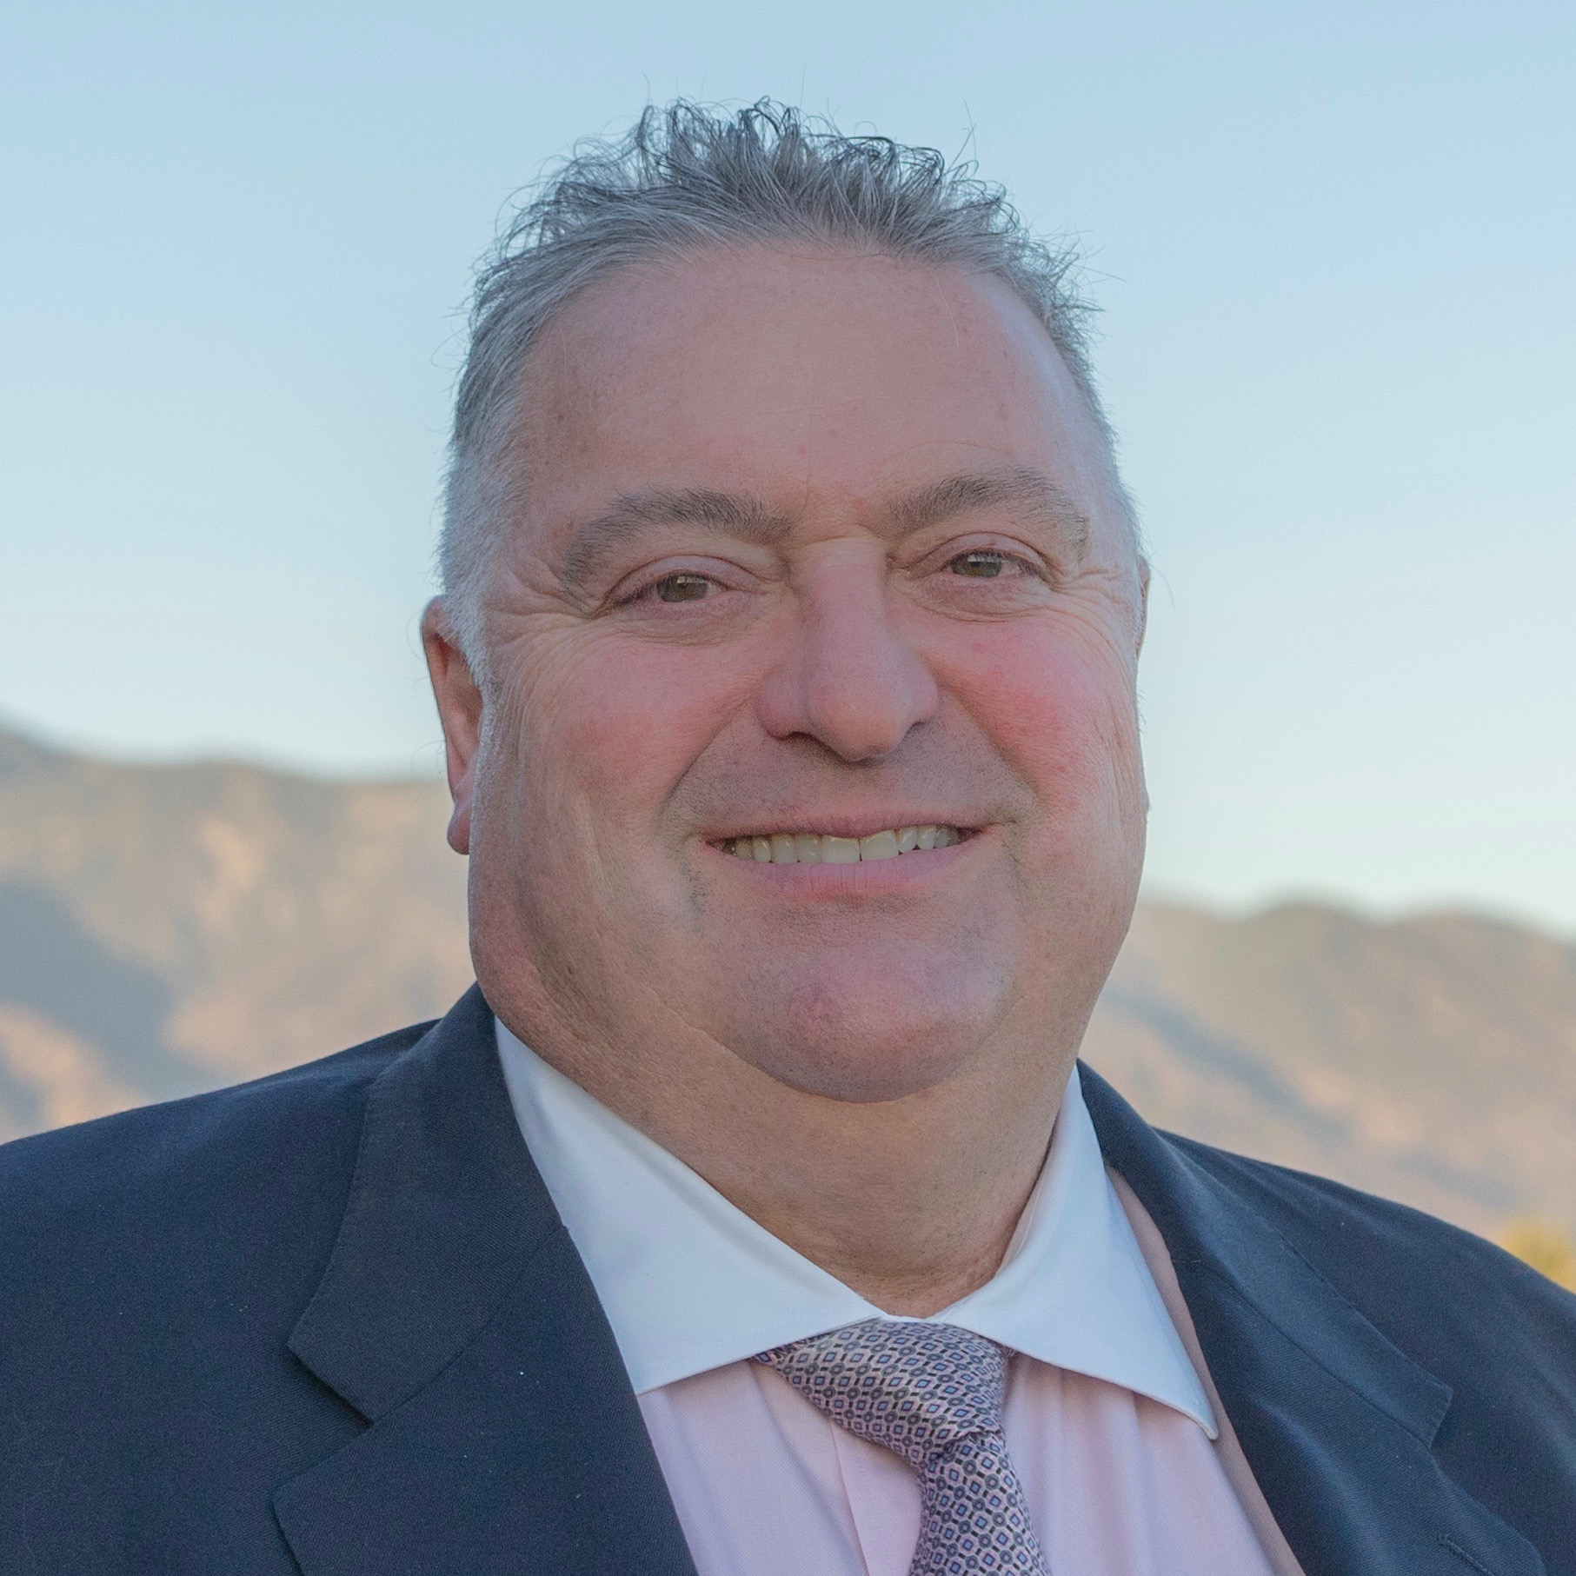
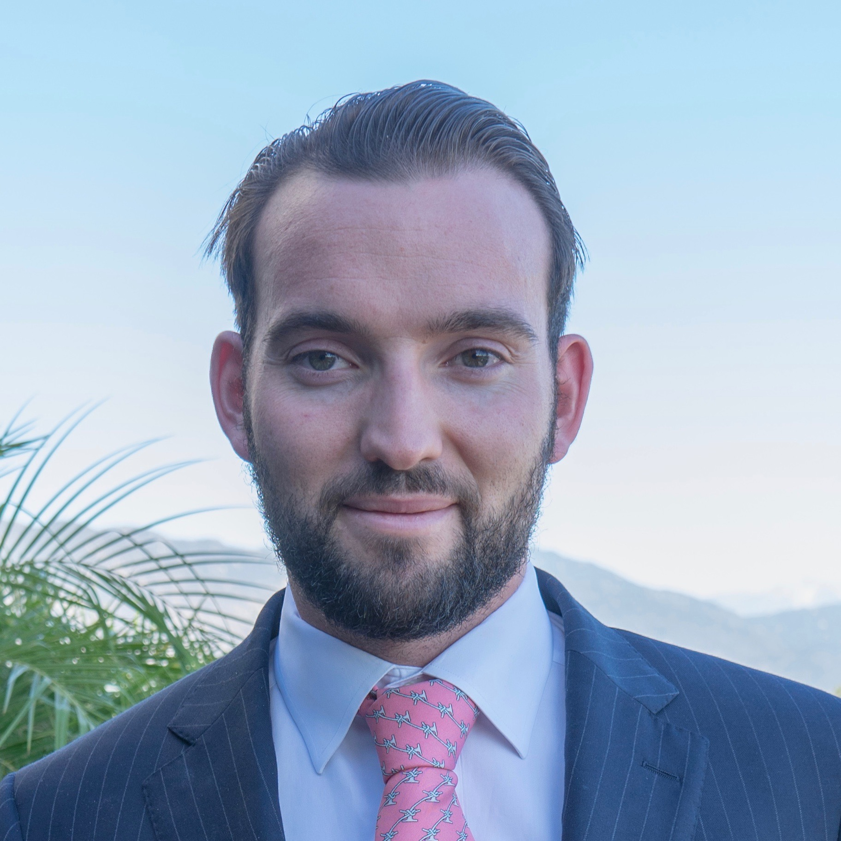
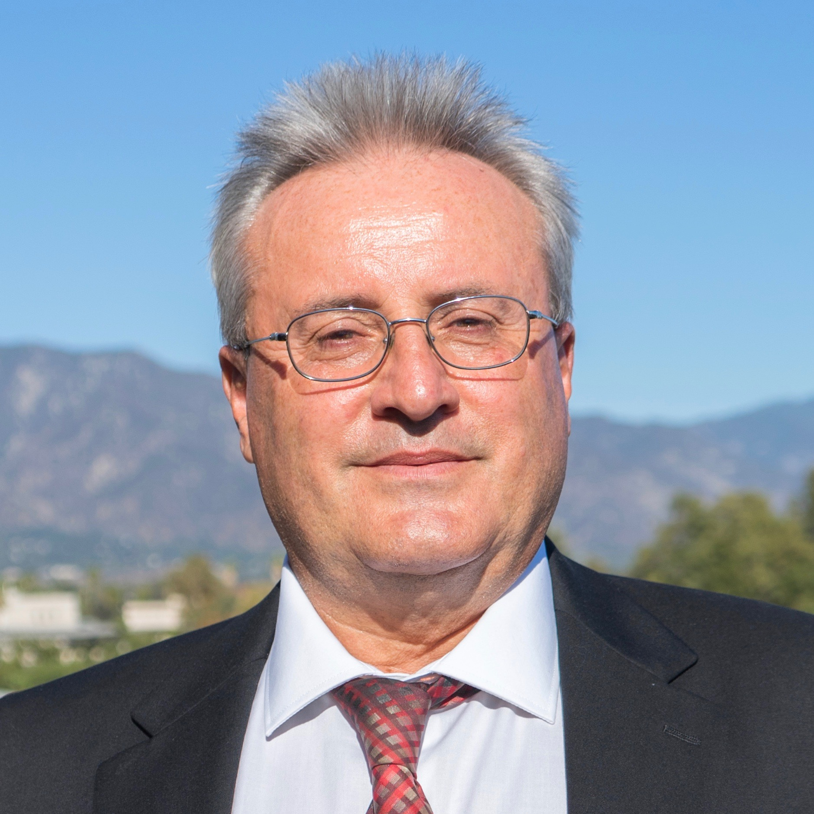
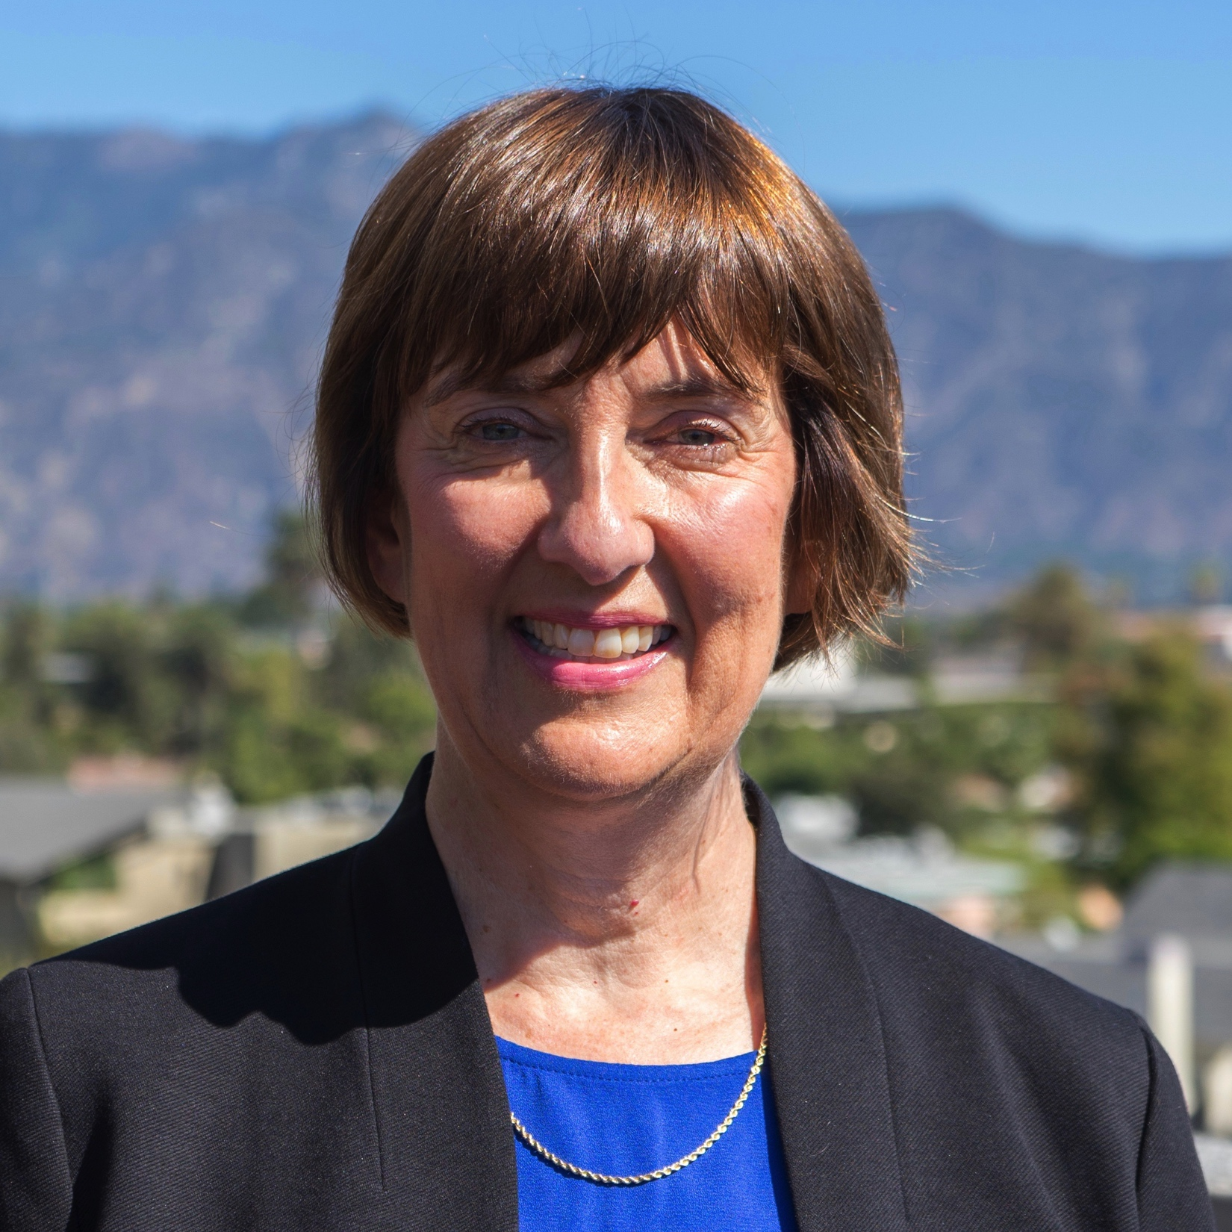
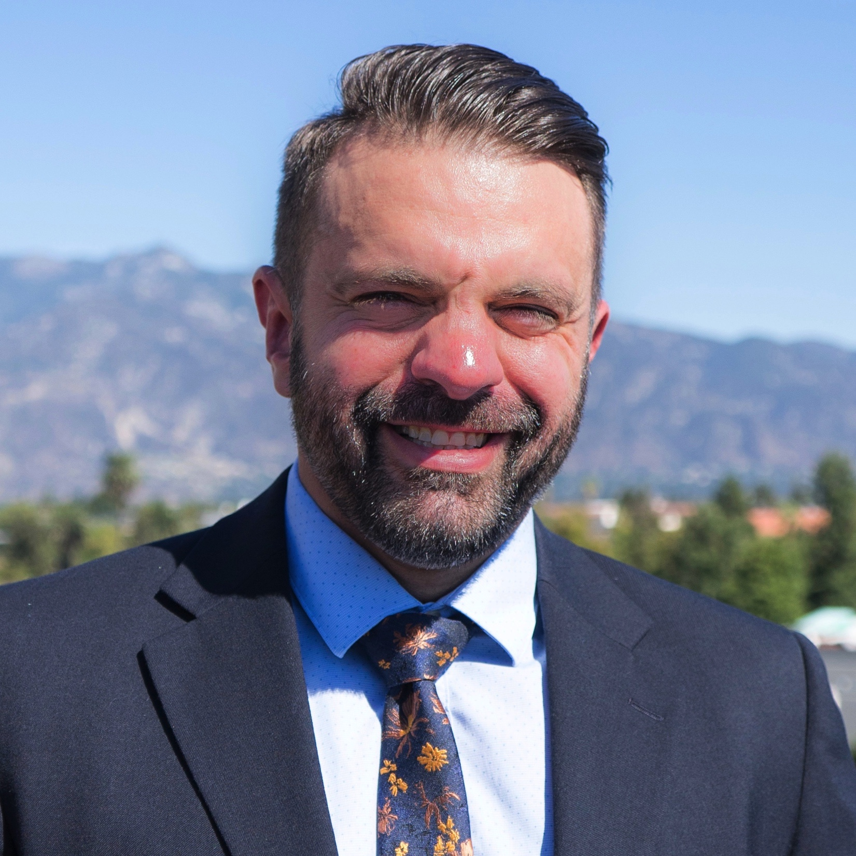
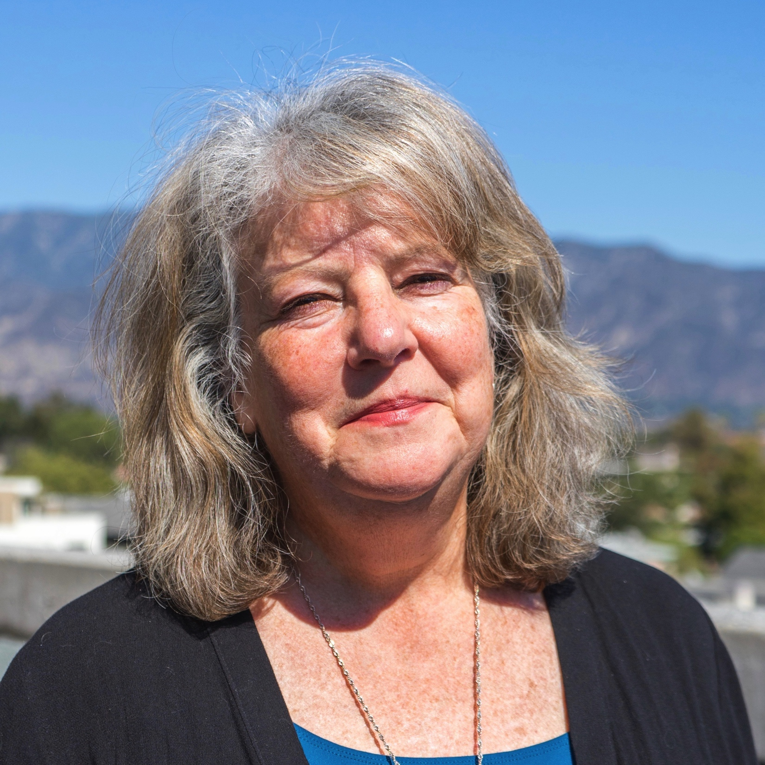
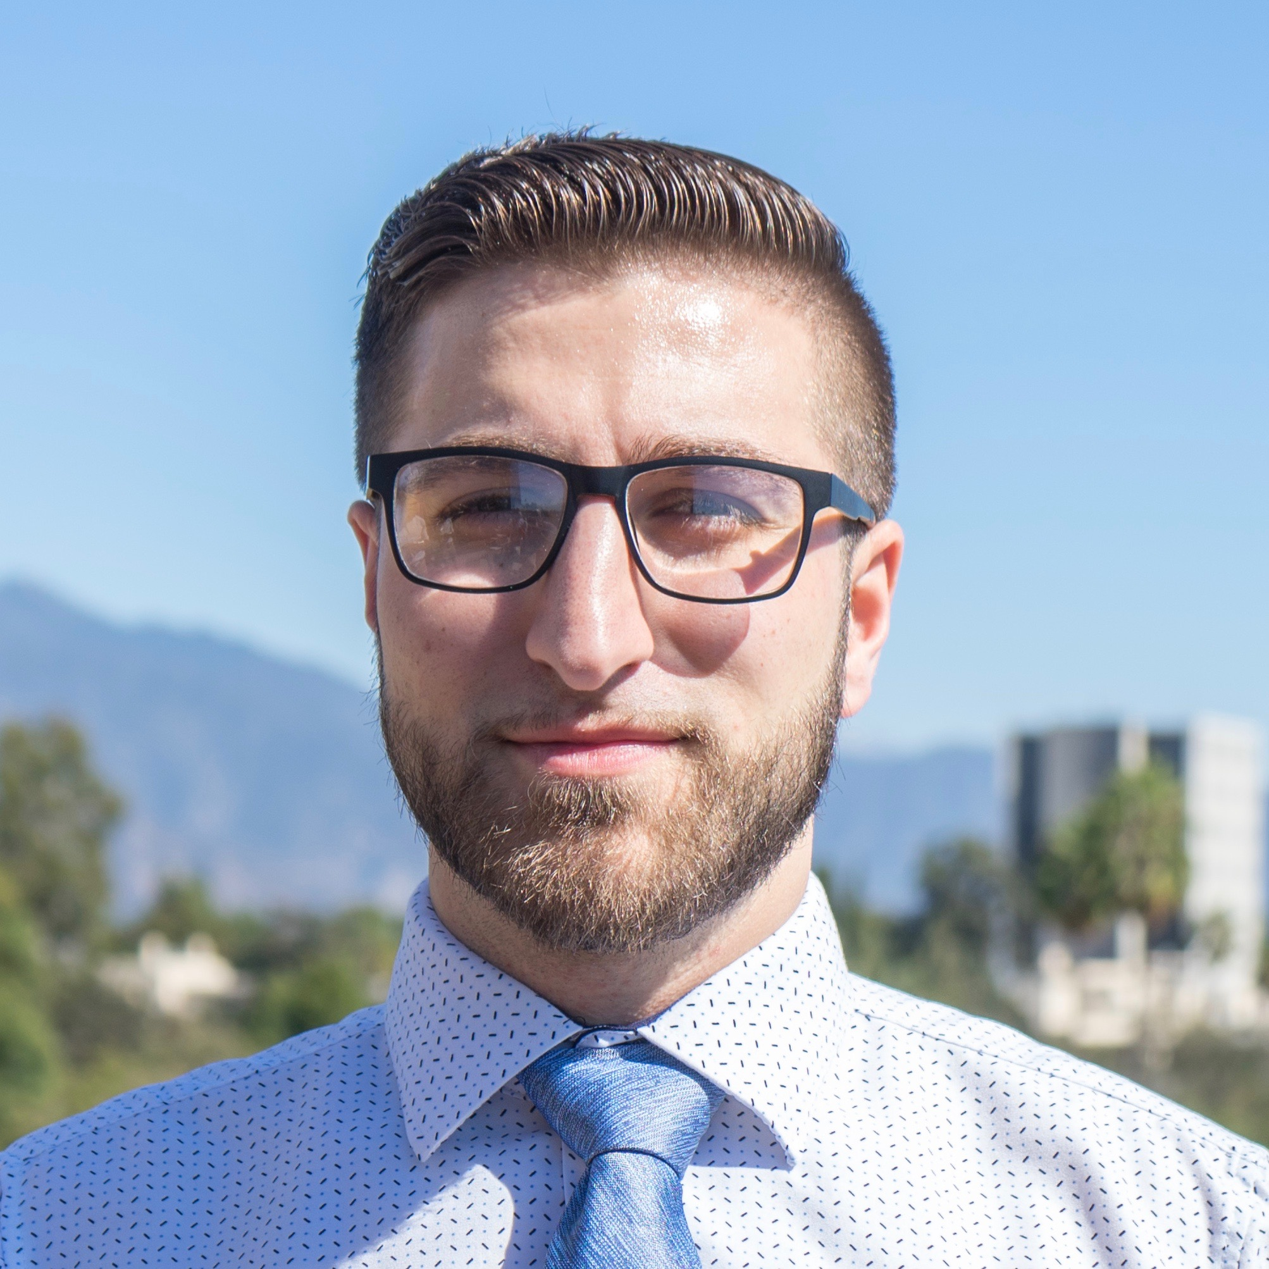
Exceptional Service Starts with an Outstanding Team
Nick Stonnington
President
Investments
Nicholas Stonnington, JR., AIF®, CPFA
Vice President
Client & Business Development
Attila Soos
Chief Financial Officer
Finance
Victoria Warren
Director of Alternative Assets
Private Asset Management
Although members of the Stonnington Group team have extensive experience in his or her specialized field, we ultimately share the same goal: working collaboratively to protect and grow your wealth.
Alex Zepkowski, CPA® Financial Planner Client Services
Chris Saccente CCO & COO
Compliance & Operations
Avo Yetenekyan Portfolio Manager Investments
17

